Slide 1
Introduction
Introductory Data Science for Innovation (995N1)
Week 1
David Eggleton
With thanks to Frédérique Bone & Daniele Rotolo
Notes:
Working on data science project, with increasingly unstructured data – you may have seen many studies which looks at patents and publication analysis – using citations;
Research evaluation, and the study of innovation is increasingly going beyond that as we need real time indicators of how Science and technology evolves, for decision makers within firms or in public office can act promptly.
The the ability work with a wide array of data (new data sources) to generate insights for science and innovation is increasingly important.
Give you an introduction of skills and techniques that we have developed in a number of projects – over the last years which enabled to develop and use a wide range of skills.

Slide 2
Today’s Agenda and LOs
Who are you? (both of us)
What are we doing?
How are we going to do this?
What’s going to be on the test?
Playtime!
Know who your module teachers
Understand the module scope
Have a basic understanding of R and RStudio
Have a basic insight of the assessment instruments for this module
Understand the very basic functions in R

Slide 3

Did you get to install RStudio or connect to RStudio cloud? Make sure you also downloaded the R script available in Canvas.

Slide 4
Who are you?

Slide 5
What are we doing?

Slide 6
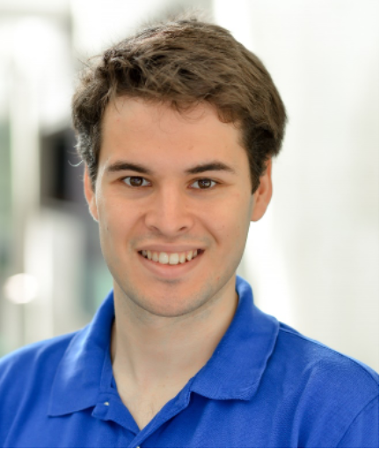
Contact Information
•David Eggleton
•PhD in Technology and Innovation Management (Sussex)
•MSc Physics (Sussex)
•BSc Physics with Management (KCL)
•Email: d.eggleton@sussex.ac.uk

Slide 7
Contact Information
•Yongyuan Huang
•PhD in progress (Sussex)
•Email: Yongyuan.Huang@sussex.ac.uk

Slide 8
What do you expect to learn in this module?

Slide 9
Outline of the course

Slide 10
Outline
Introduction to programming and data manipulation:
Week 1: Introduction
Week 2: Data structure
Week 3: Data Collection and Transformation

Slide 11
Lecture outline
Data in the wild:
Week 4: Data sources and innovation indicators innovation 1
Week 5: Data sources and innovation indicators innovation 2 (Guest lecture – ResearchFish TBC)

Slide 12
Lecture outline
Analysing innovation data:
Week 6: Textual data and text-mining (P1)
Week 7: Textual data and text-mining (P2)
Week 8: Data visualisation
Week 9: Introduction to machine learning

Slide 13
Lecture outline
Wrapping up:
Week 10: Revisions
Week 11: Data Science, Policy and Practice (Guest lecture –TBC)

Slide 14
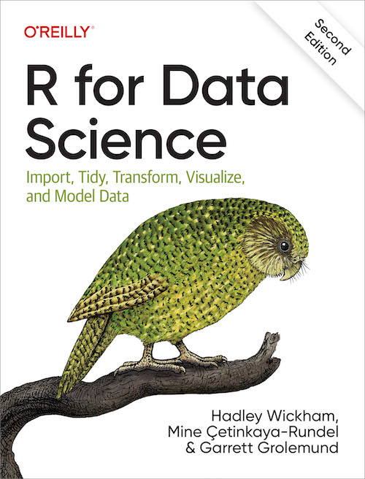
Textbook (R)
R for Data Science (2nd edition)
Free website
Physical copy available for purchase
https://r4ds.hadley.nz/

Slide 15
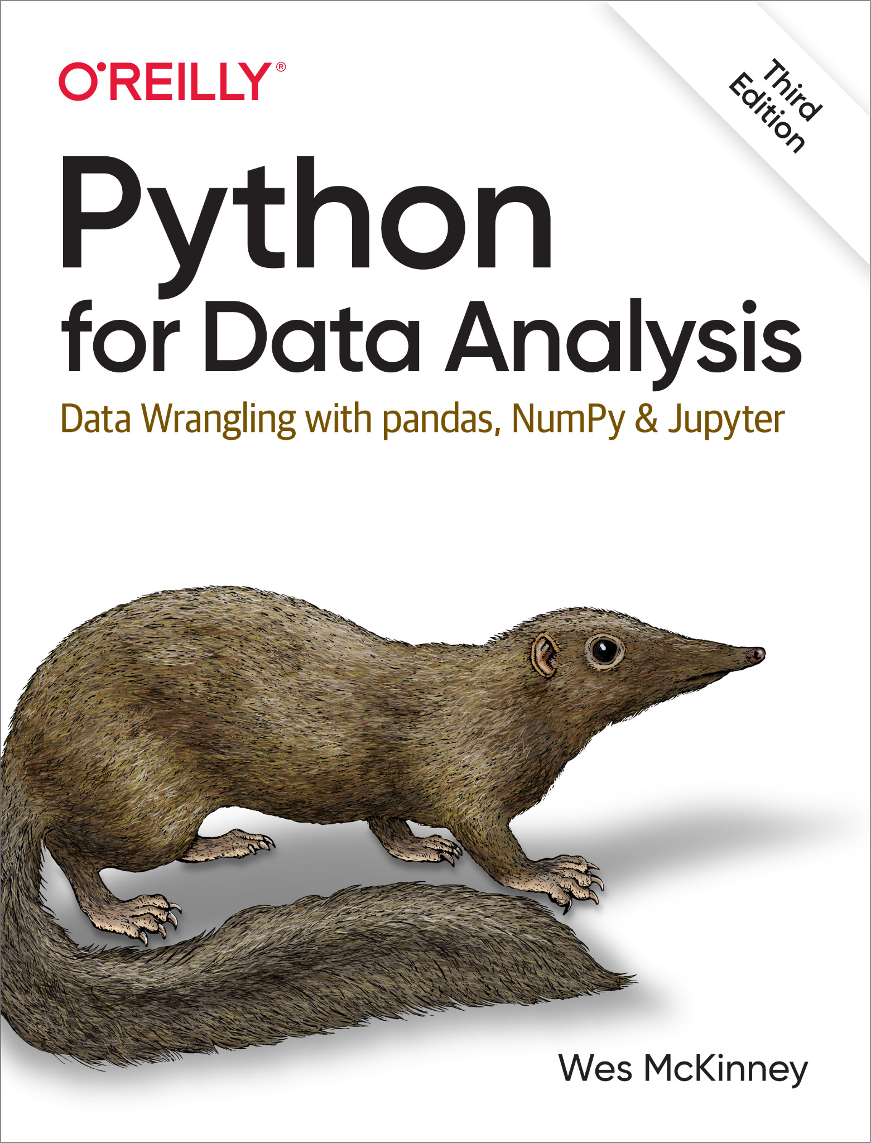
But for funsies
I will also be (trying to) transpile the entire module into Python and will make things available to you in as near to real-time as I can through a separate git
Different textbook (but still free!!!)
Python for Data Analysis (3rd Edition)
https://wesmckinney.com/book/
Many of the fundamentals from the first few weeks transfer over perfectly
Other times things are easier in a different language
SQL

Slide 16
What is Data Science?

Slide 17
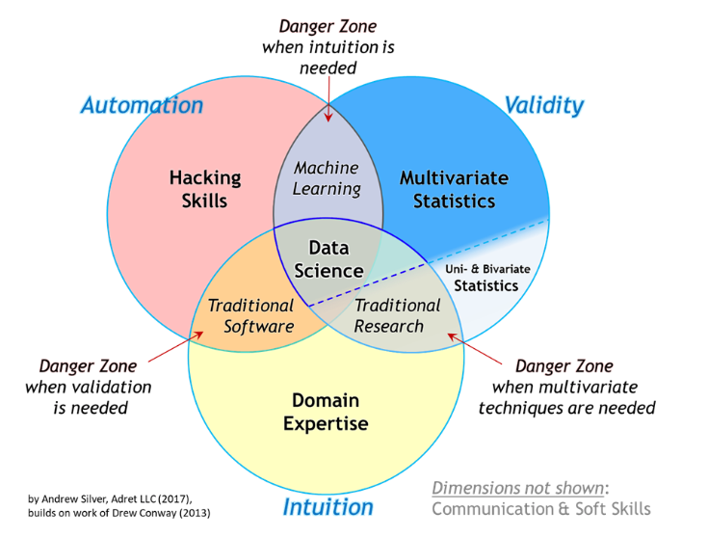
What is data science?
Source: Andrew Silver, https://towardsdatascience.com/the-essential-data-science-venn-diagram-35800c3bef40

Slide 18
What is data science?
Semester 1 modules
Source: Andrew Silver, https://towardsdatascience.com/the-essential-data-science-venn-diagram-35800c3bef40

Slide 19
What is data science?
Semester 2
quant modules
Semester 1 modules
Source: Andrew Silver, https://towardsdatascience.com/the-essential-data-science-venn-diagram-35800c3bef40

Slide 20
What is data science?
Introduction to Data Science for Innovation
Data processing
Automation
Intro to ML
…
Semester 2
quant modules
Semester 1 modules
Source: Andrew Silver, https://towardsdatascience.com/the-essential-data-science-venn-diagram-35800c3bef40

Slide 21
What will you learn in this module?
What you will learn on other Semester 1 modules?
You will develop an understanding of science and innovation policy with associated concepts and literature: together with your practical knowledge of science and technology policy, this provides you with ‘domain expertise’.
This course aims to provide you with practical skills:
To work with innovation related data (‘into the wild’)
To clean and transform data in an efficient manner
To generate analysis and visualisation for policy and decision making
Through the use of computational tools (learning how to program)

Slide 22
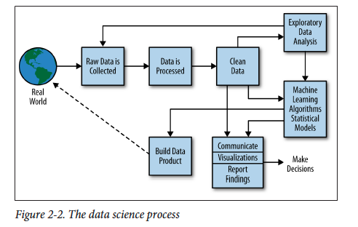
What is data science?
Source: The Data Science Process, By Rachel Schutt & Cathy O’Neil, Doing Data Science, P. 41
Notes:
Because all part of this process is important we will give you the tool for doing each steps (but to become proficient you will need much more practice).

Slide 23
What is data science?
Data work is an important part of the work
Source: The Data Science Process, By Rachel Schutt & Cathy O’Neil, Doing Data Science, P. 41
Notes:
Discuss how informatics students are taught about how to use machine learning
There may be a mis-conceptions that most useful data exists in nice structured format -> this is only the case for a narrow set of data
Data cleaning and early exploratory analysis is key to understand whether you need to collect further data or do further data processing or understand how your data may be biased.

Slide 24
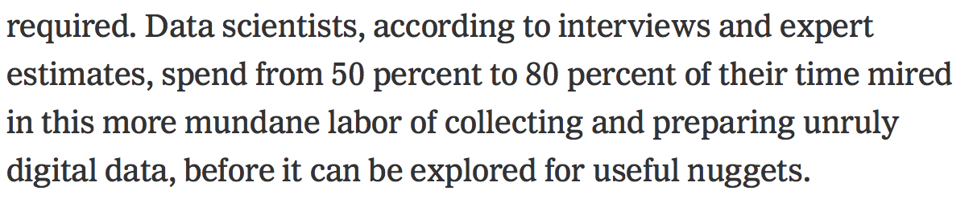
What is data science?
Source: New York Times , 17 Aug. 2014
For Big-Data Scientists, ‘Janitor Work’ Is Key Hurdle to Insights
Notes:
Also discuss how important it is to understand data that you are using. How it is collected, and there are some things that cannot be collected in a quantitative manner.
Thinking about the rgith data to get, how to collect it is important, but also that you have to manage your expectations as to how much data cleaning you do vs processing.
So we are going to work on how to process quantitative data, but this does not mean that it is always the best data to use.

Slide 25
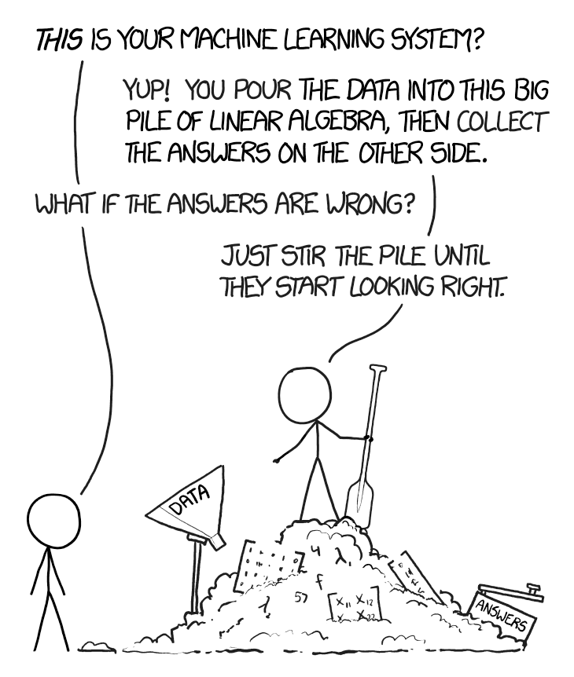
What is data science?
Garbage in 🡪 Garbage out
https://xkcd.com/1838/
Notes:
Also discuss how important it is to understand data that you are using. How it is collected, and there are some things that cannot be collected in a quantitative manner.
So we are going to work on how to process quantitative data, but this does not mean that it is always the best data to use.
Not all problem or phenomena can be well studied with data science – while in this course we are going to look at how to best manage unstructured data, you should not always assume that the best way to study a phenomena is through these sets of tools.

Slide 26
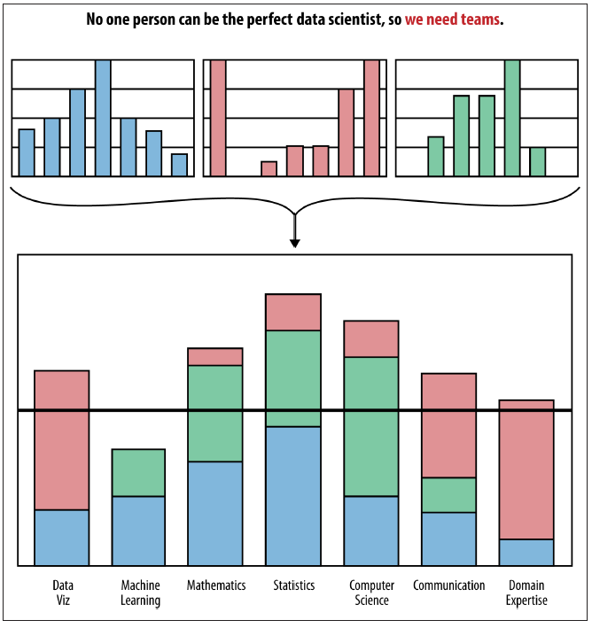
What is data science?
Source: The Team profiles, By Rachel Schutt & Cathy O’Neil, Doing Data Science, P. 12
Notes:
Teams have different skills
Even if you don’t want to become a data scientists, understanding and practicing these skills may mean that you would be more effective as part of a team to generate policy evidence.
Also, it may be that you may think- if working with other people within a team other with more technical knowledge may have more knowledge then you. May not be able to reflect on the quality of the data, is the data collected a good representation of what you actually want to observe? I get some results, what does it actually mean? What does it not look like what I expected?
You have very valuable knowledge about the data, the way to understand results, and actually what policy makers, or stakeholders – what do they actually want to see or to know – how you should communicate to them?

Slide 27

Impression vs reality
https://hackertyper.com/

Slide 28
Introduction to Data Science for Innovation
You won’t become computing/machine learning experts.
But you will gain knowledge on the workings of each part of the pipeline with practical cases of science and innovation data.
You will learn how to learn.
It’s up to you to take your knowledge to the next level.

Slide 29
Learning to program

Slide 30
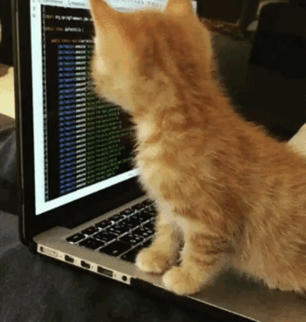
Learning to program
Do you have any programming experience?
Notes:
How many of you have done any programming?

Slide 31
Learning to program
Do you have any programming experience?
Don’t worry we’ll teach you the basics …
Notes:
How many of you have done any programming?

Slide 32
Learning to program
Do:
Be patient – these skills are difficult to learn
Remember where you started and look at your own progress
Reflect on how these skills can help your analysis
Practice, practice, practice …
Seek help from your colleagues
If you get frustrated take a break and come back with fresh eyes
Don’t:
Give up after getting error messages (google is your friend)
Compare yourself with colleagues who have more skills and interest than you
Think that higher technical skills is better

Slide 33
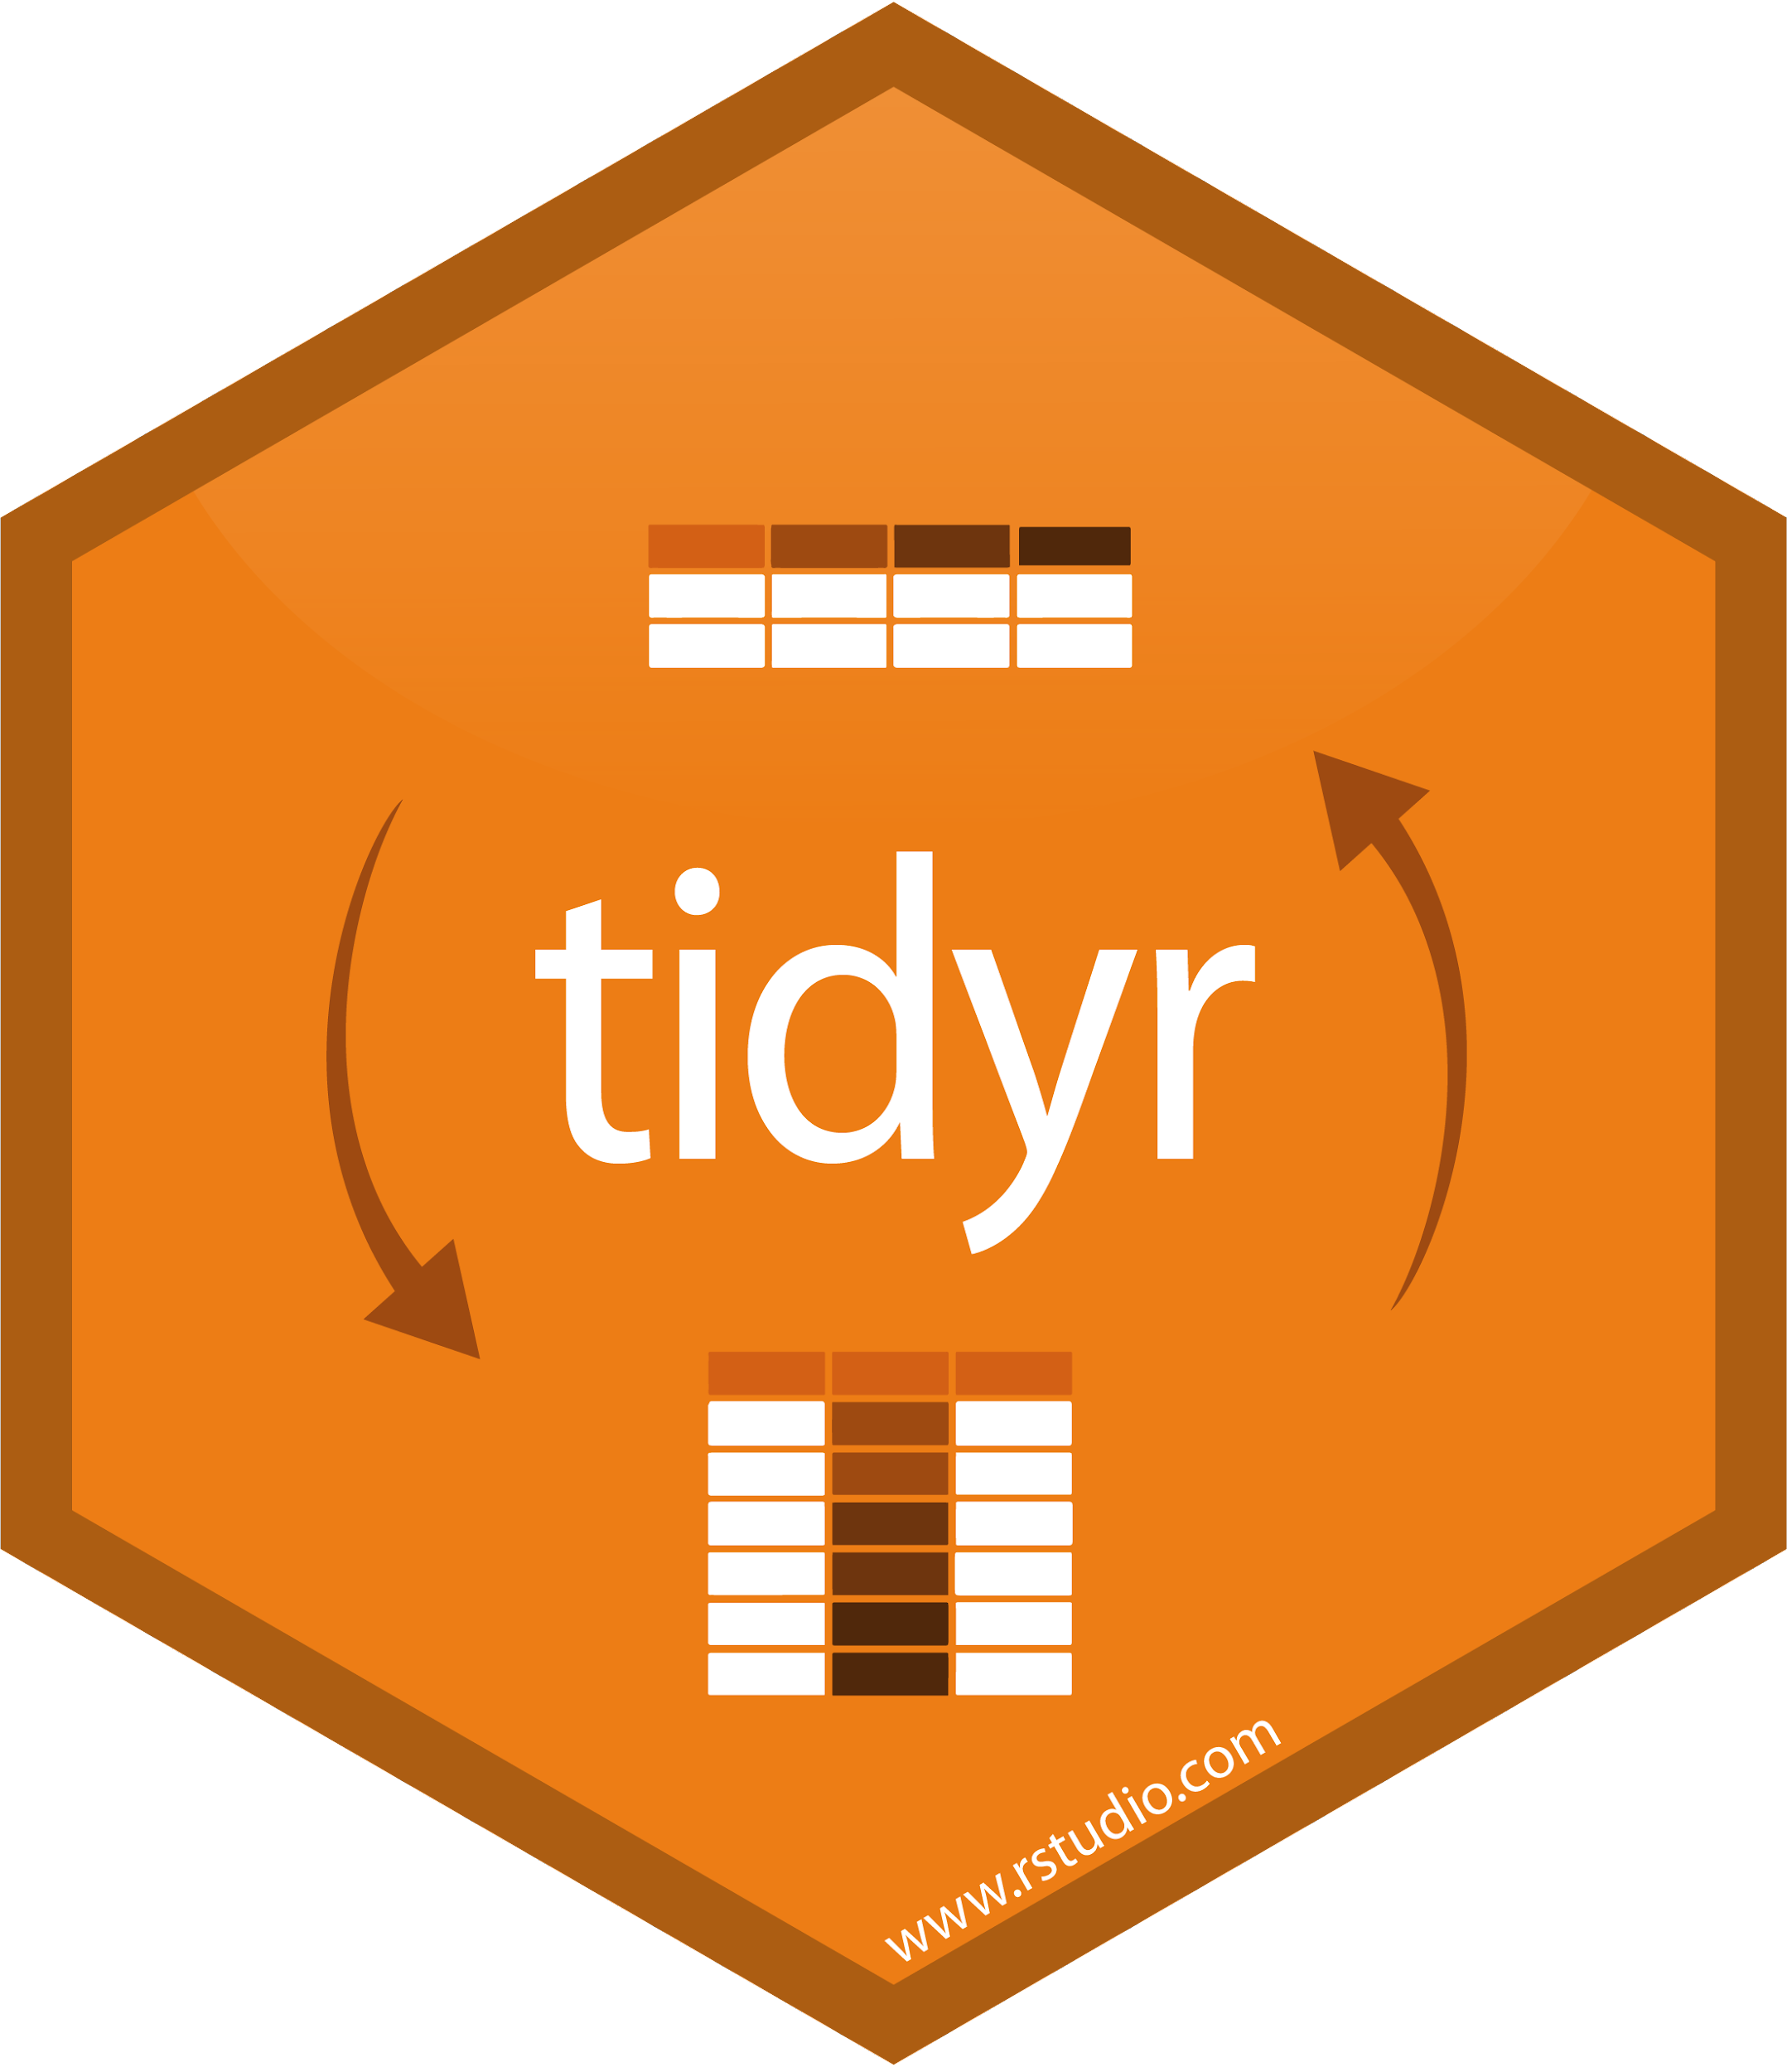


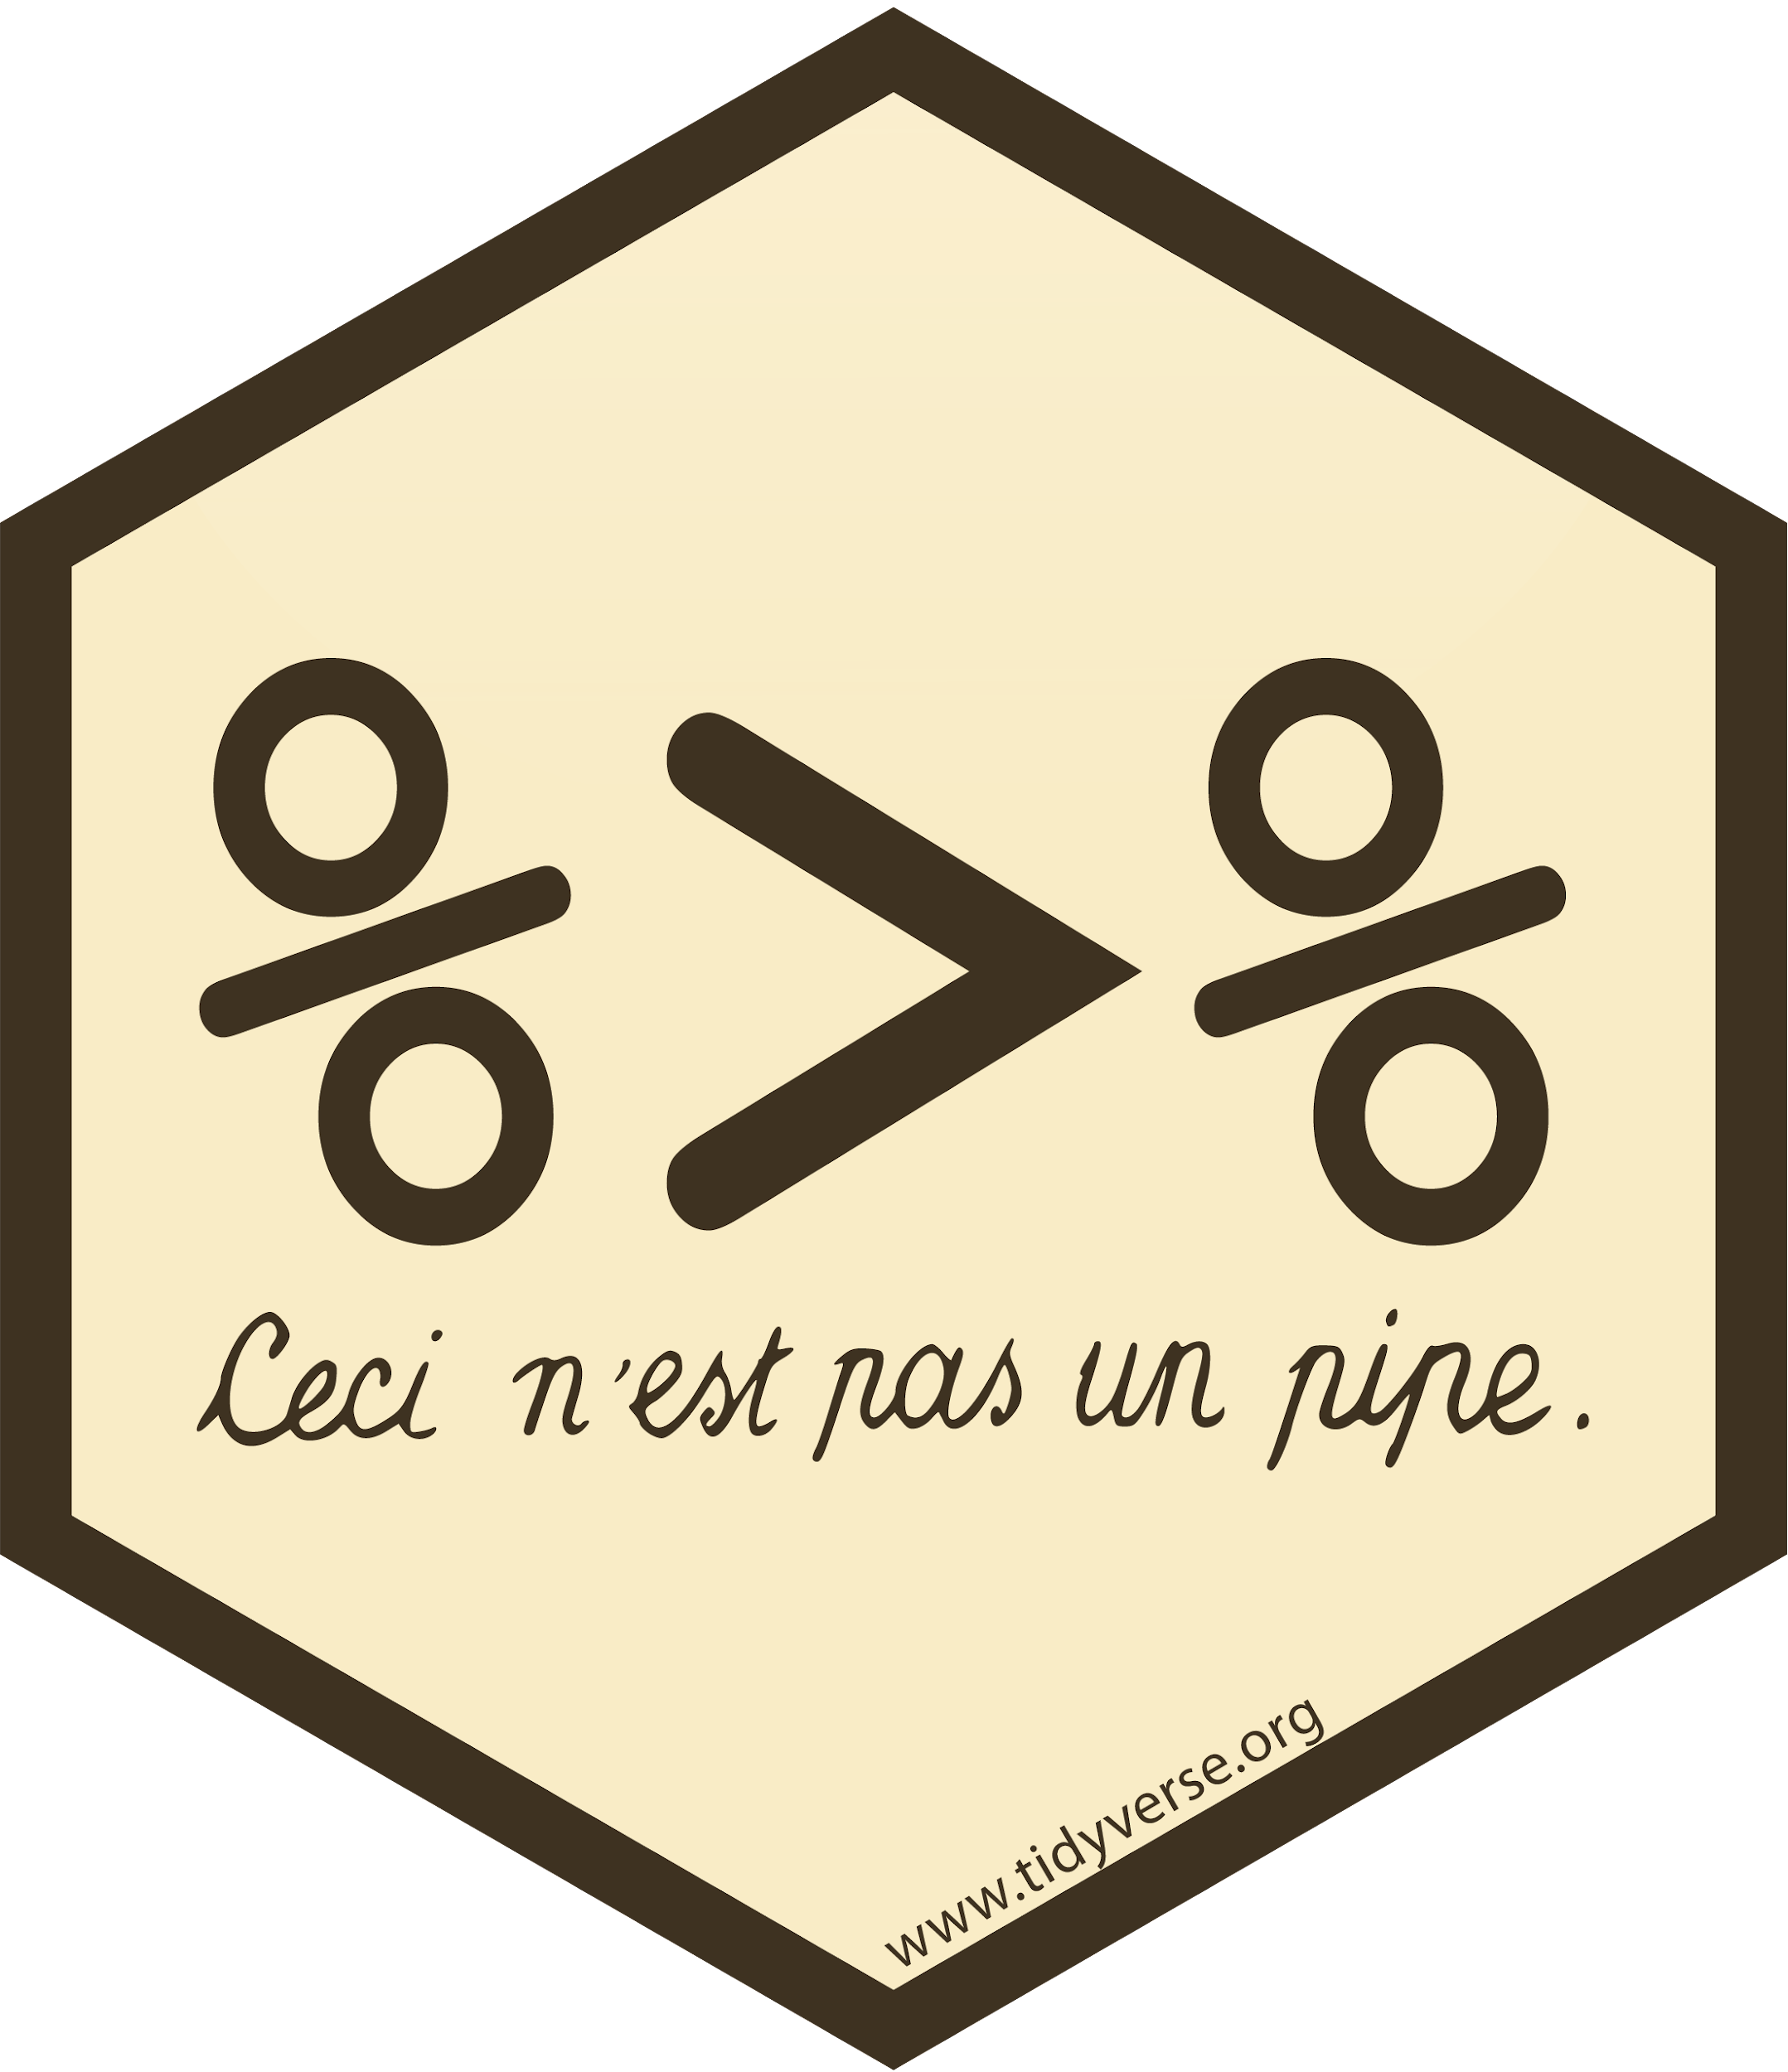




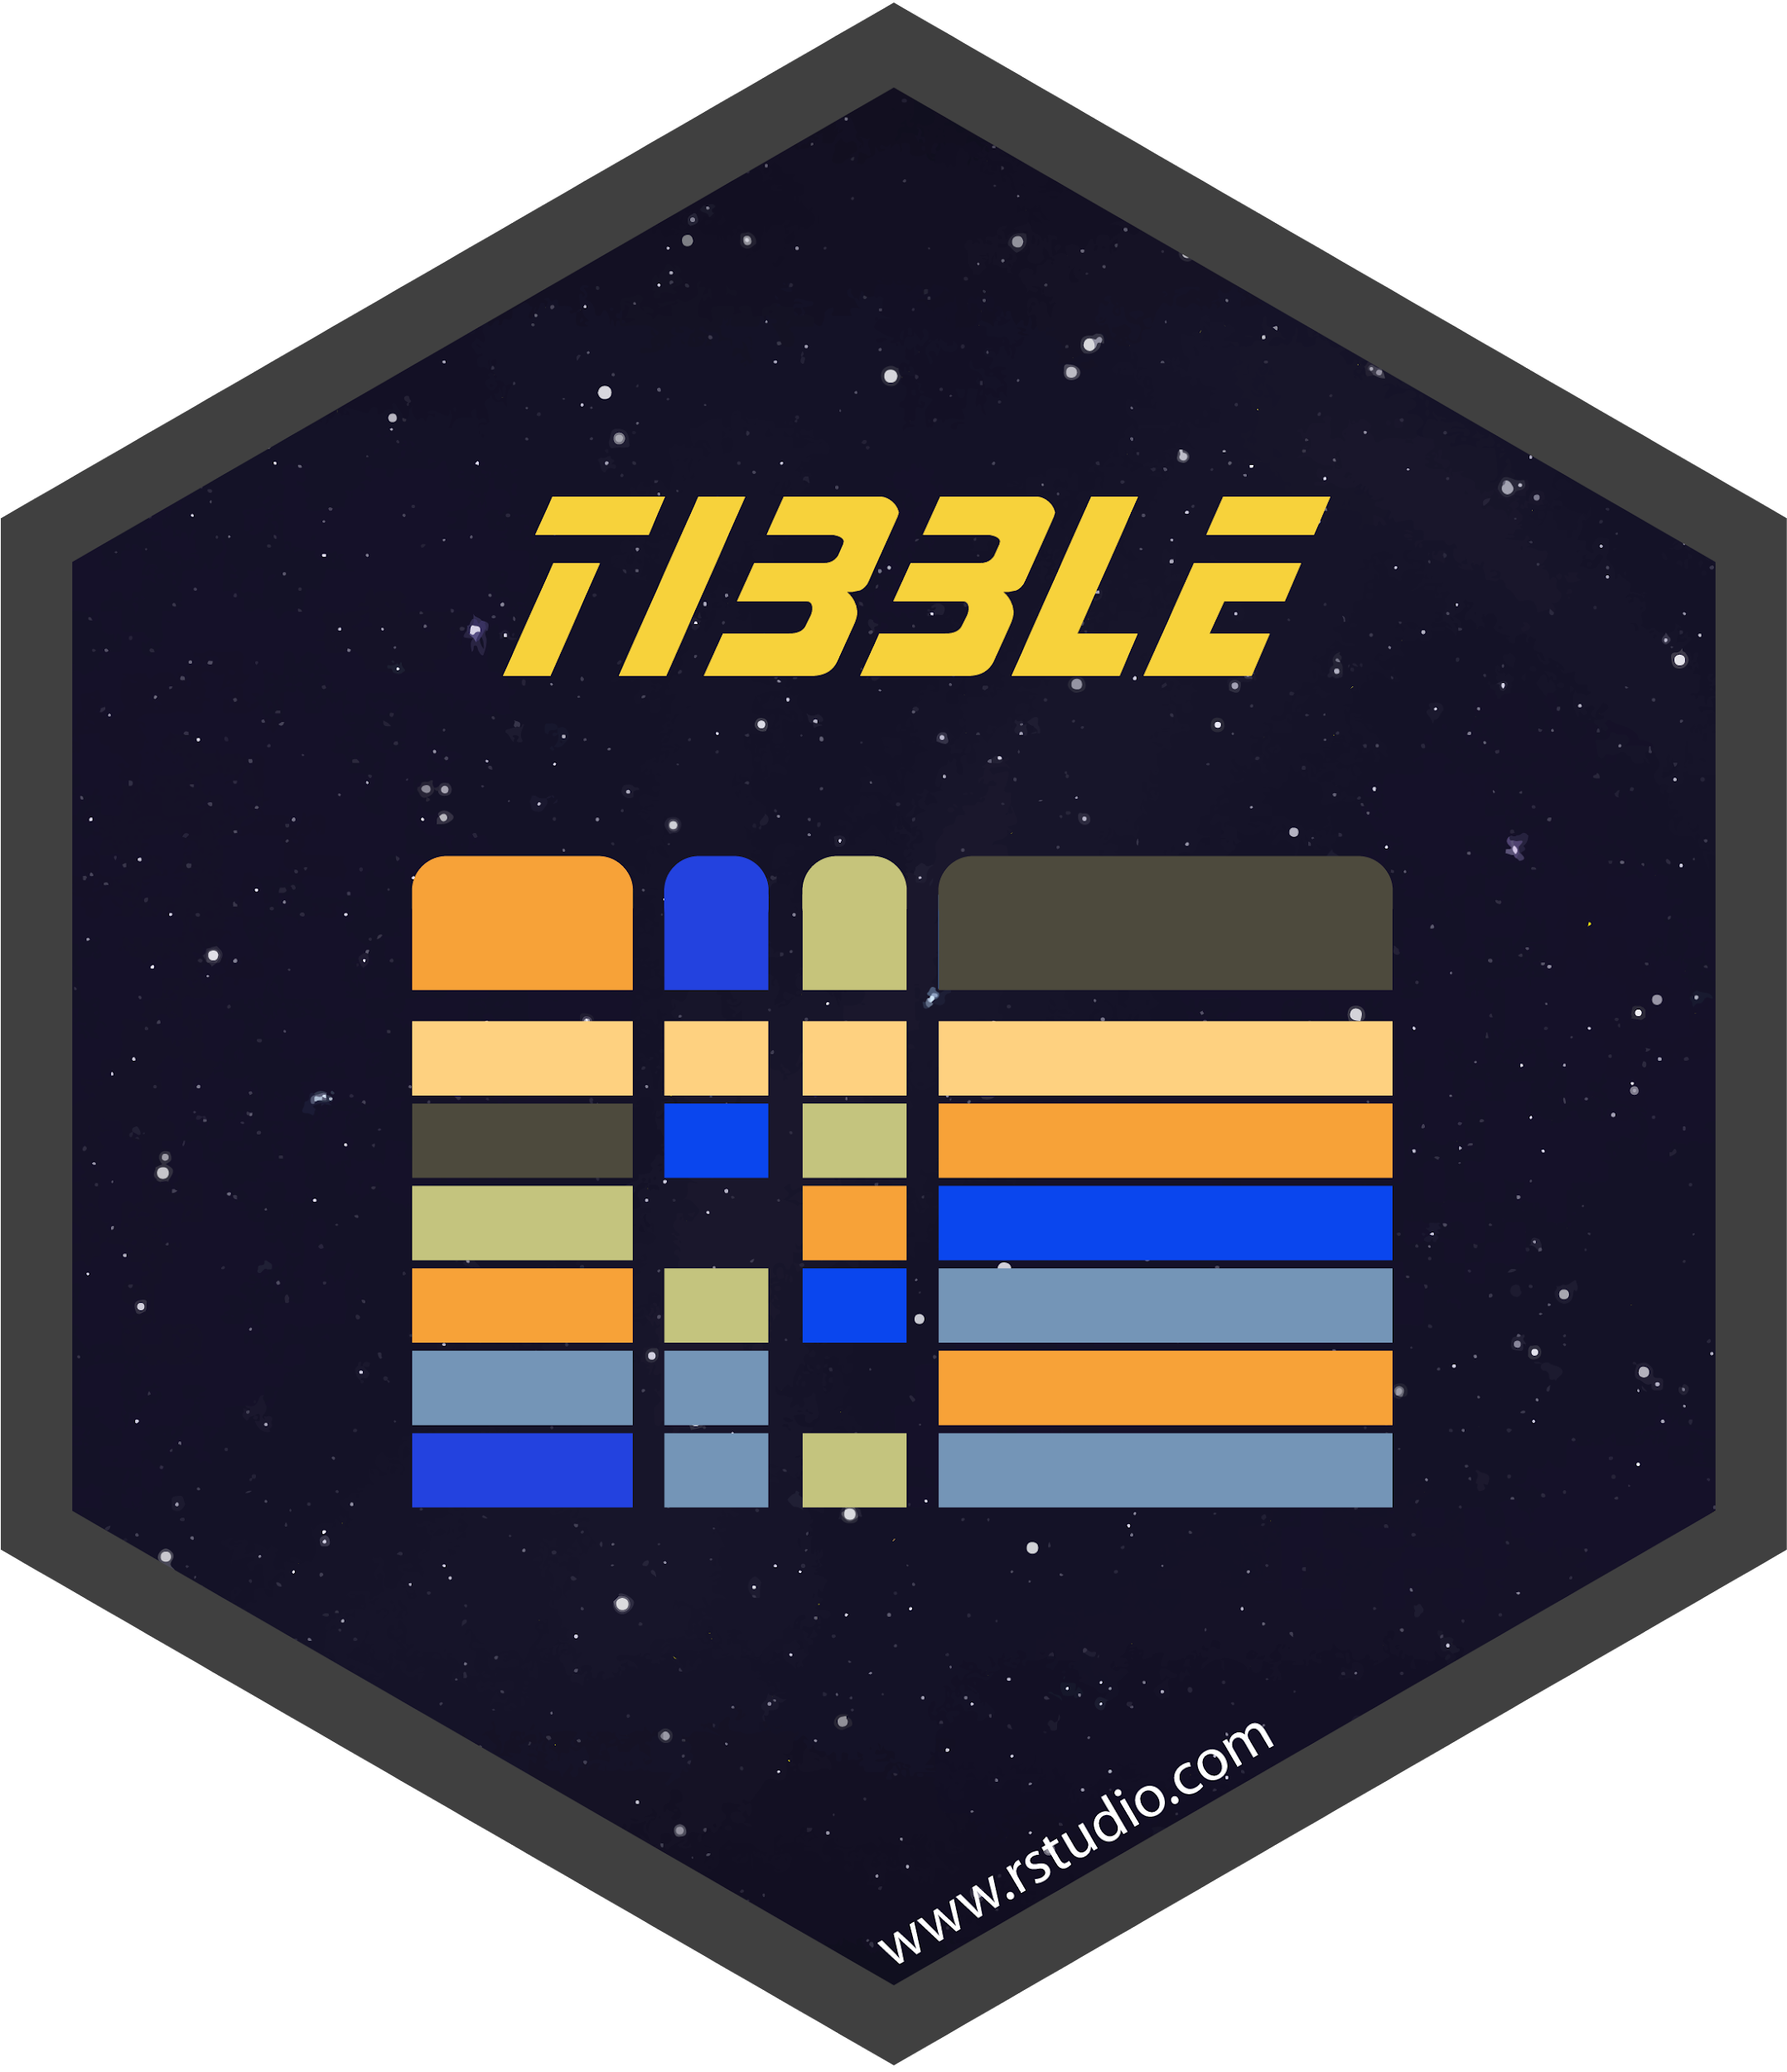



Learning to program
What language should I learn?
Wrong question - like saying ‘hammer or screwdriver - which tool should I buy?’
We will be experimenting with both R and python (maybe even SQL)!
R is an easy(ish) to use language
It started as a language for statistics
But becomes increasingly popular for data science projects (citation needed)
It includes many packages for:
importing data
data wrangling
data visualisation
Comes with a painful user
interface (but I can’t fault pipeline operators)

Slide 34
Learning to program
The workshops will give you hands-on exercises to learn how to use R and also python
Introduce the RStudio and python through VScodeenvironment.
Getting data and handling them in R/Python
Using programming logic to solve problems
Working with text data
Introduce machine learning
Visualise the data to take decisions

Slide 35
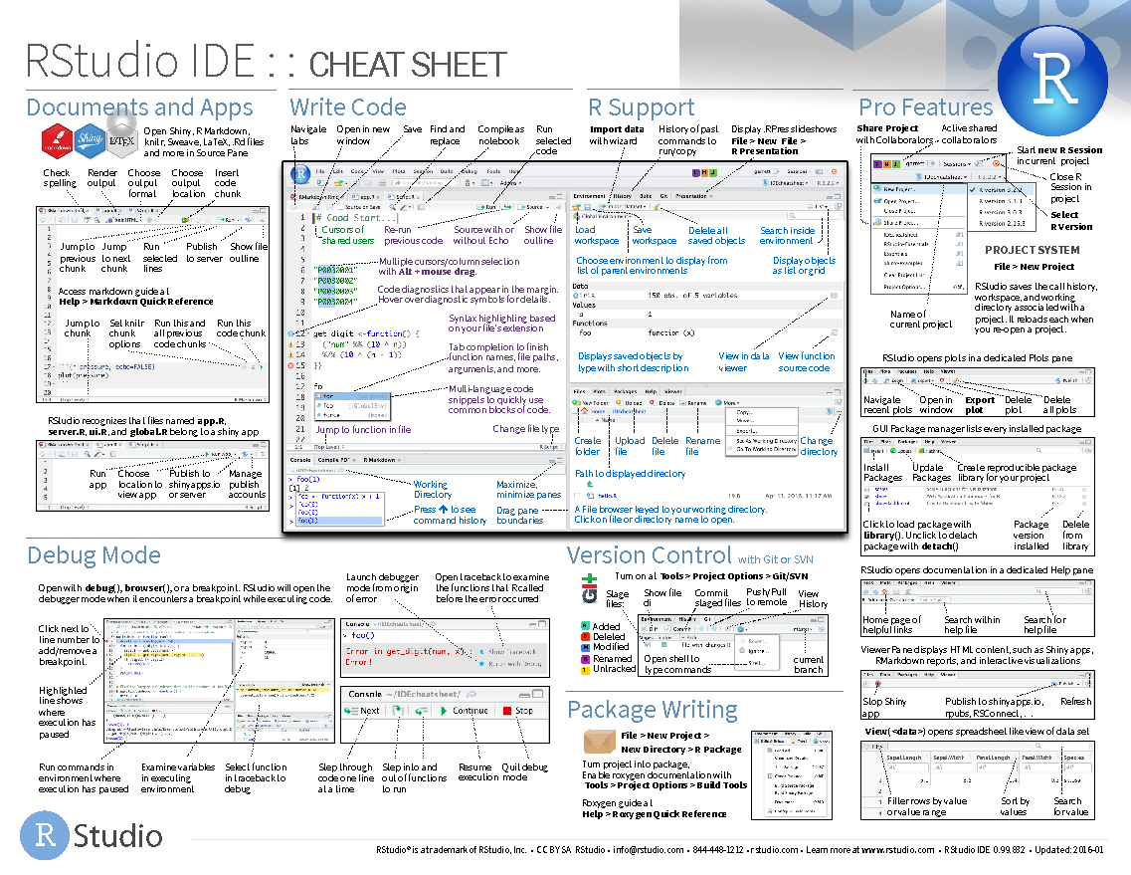
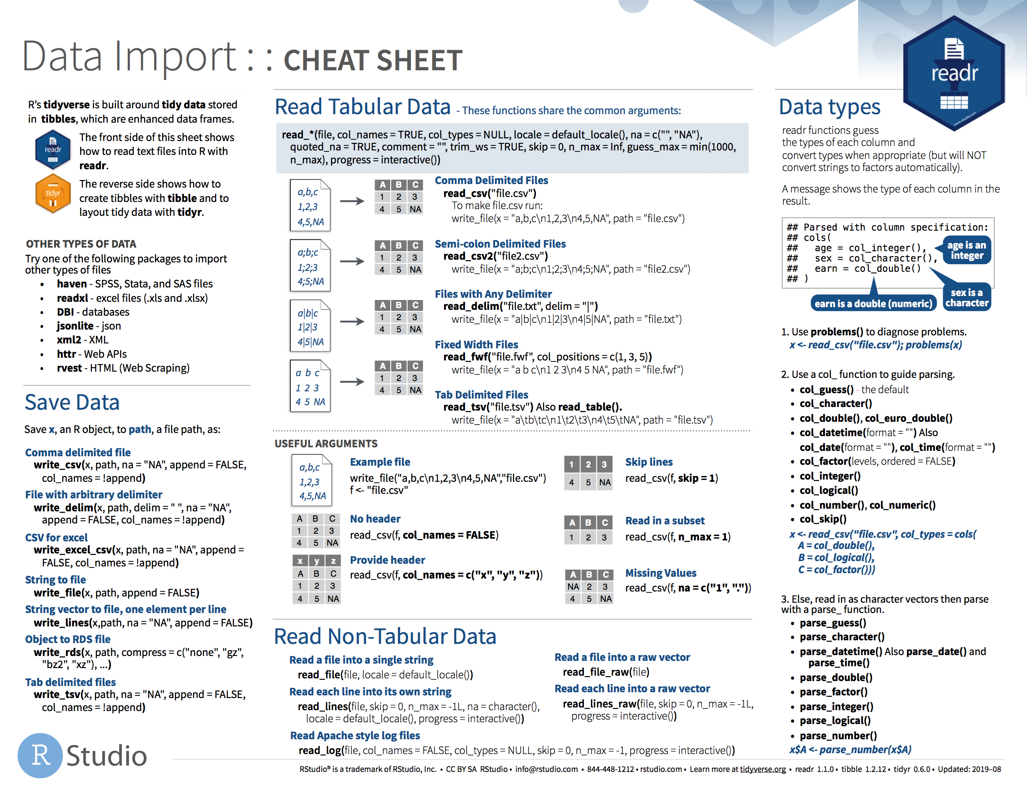
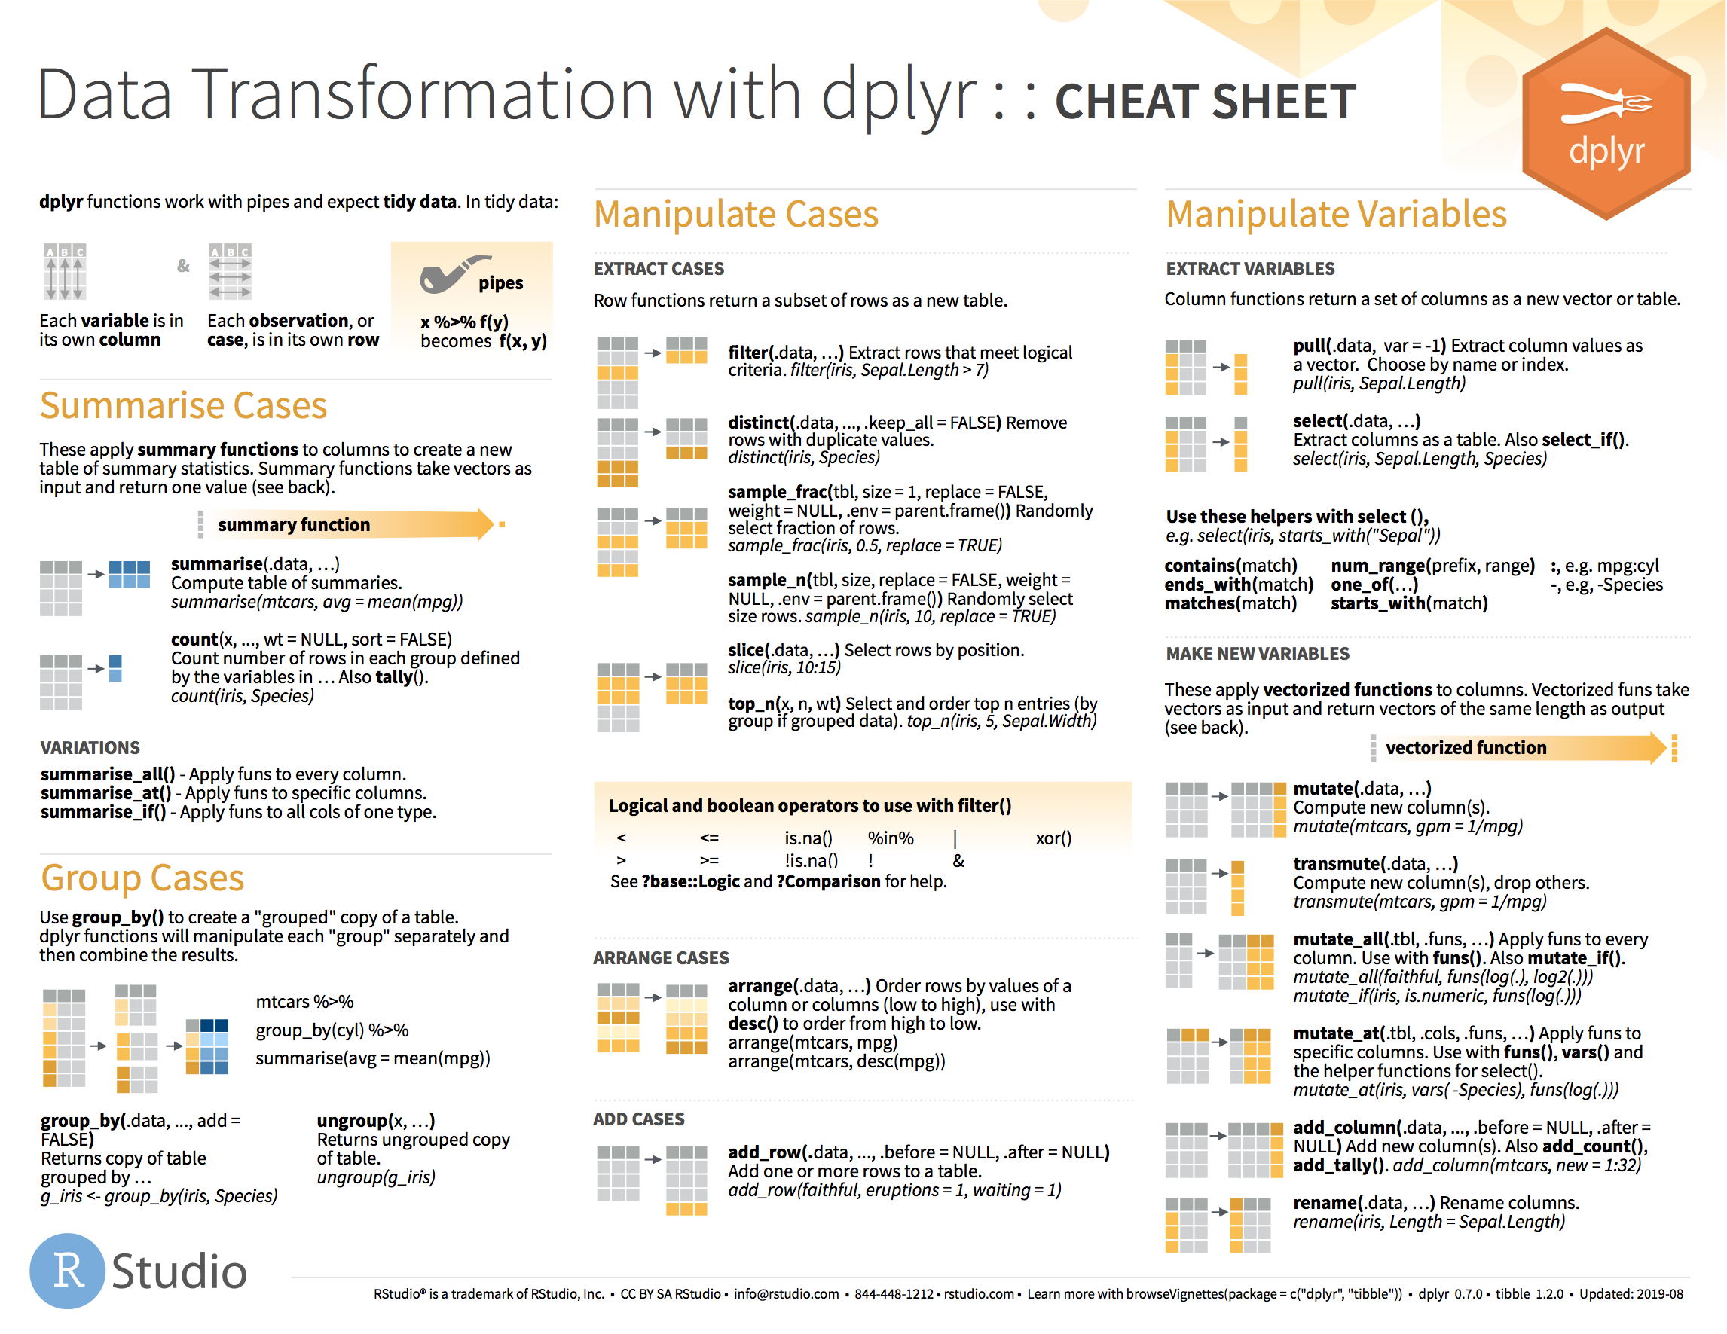
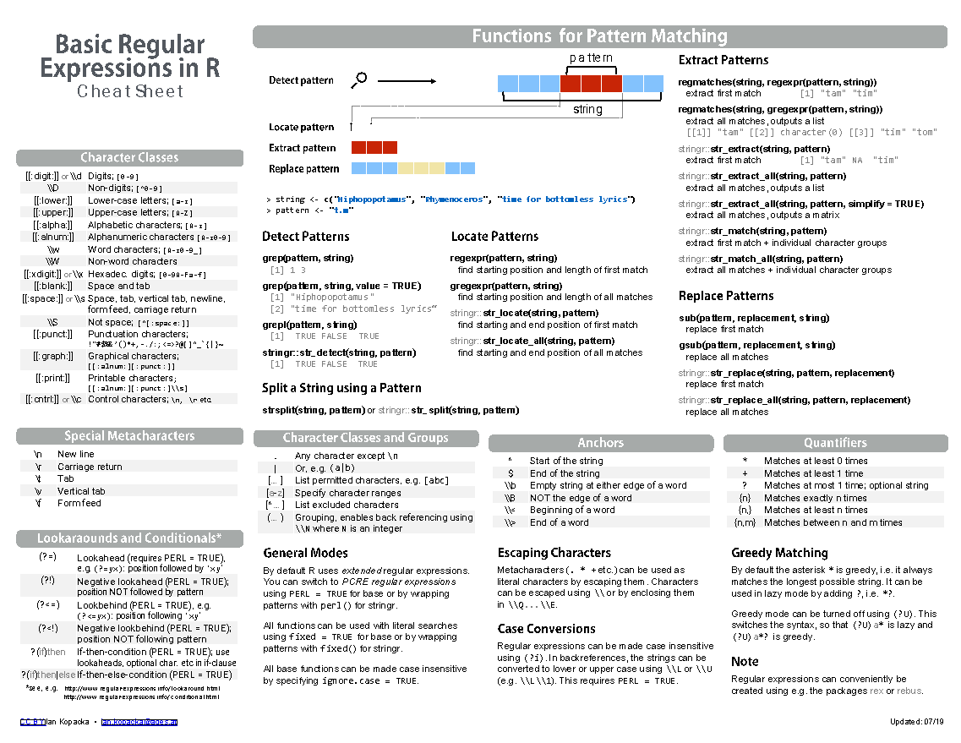
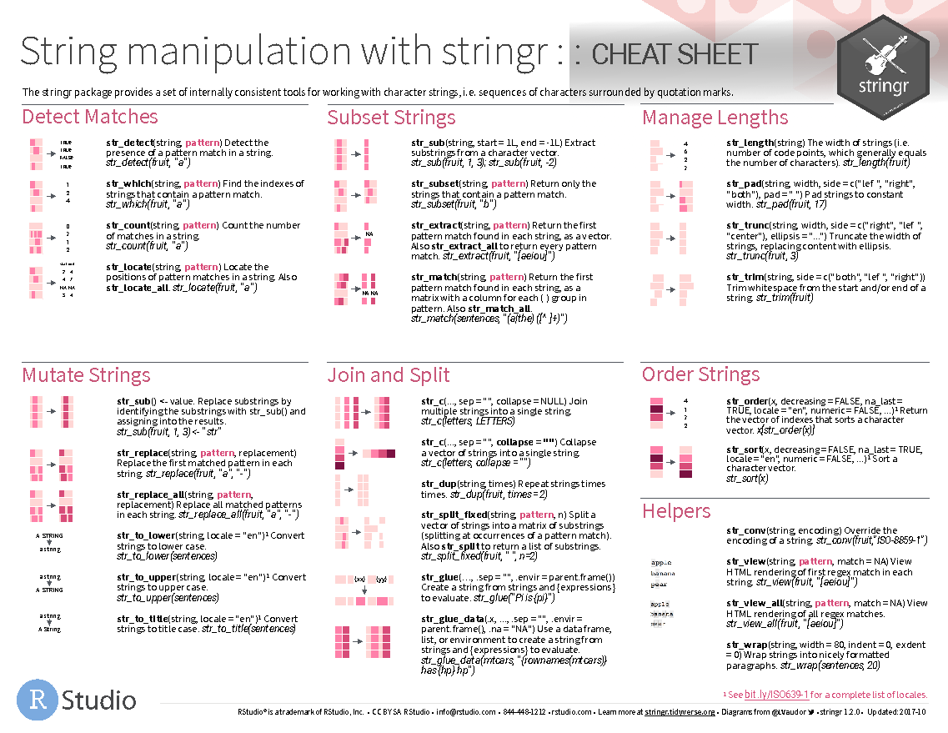
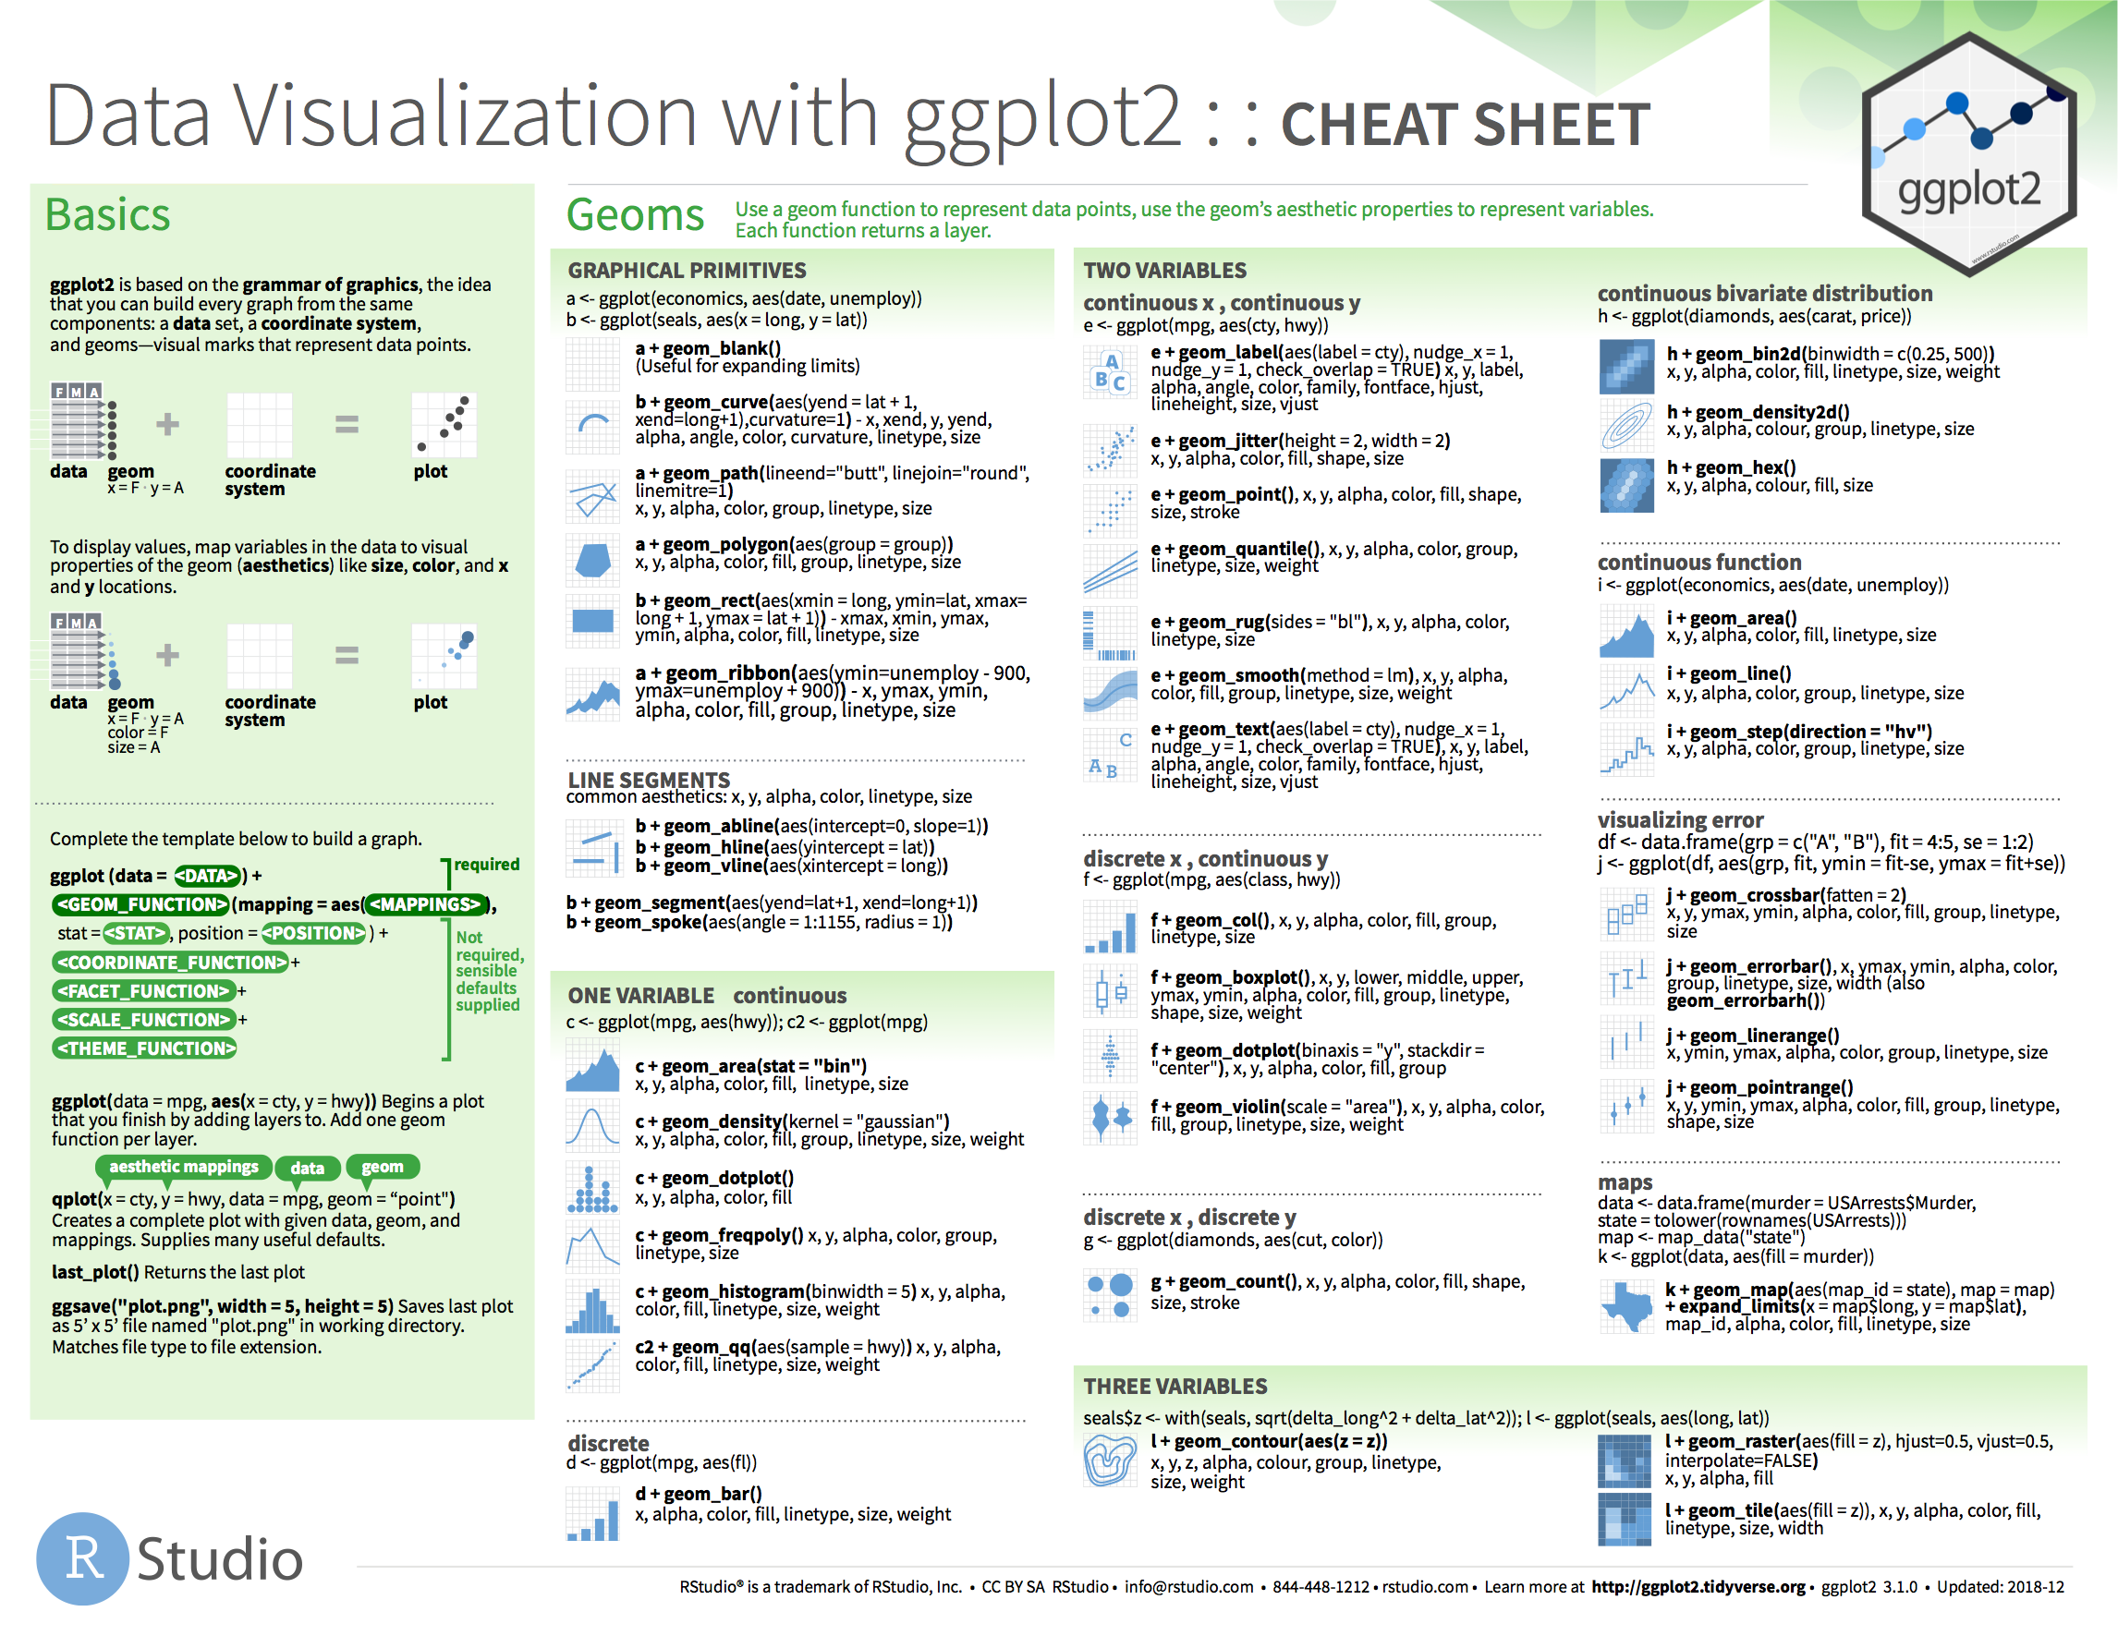
Learning to program
There is a lot of useful functions in all the
packages available (maybe too many to remember):
Use Cheat Sheets
https://rstudio.com/resources/cheatsheets/
Notes:
You won’t need to remember everything by heart. You should learn by practicing. The more you practice, the more you will remember the important functions.
You can’t remember everything, and CS are a good way to remember how different packages may be used.

Slide 36
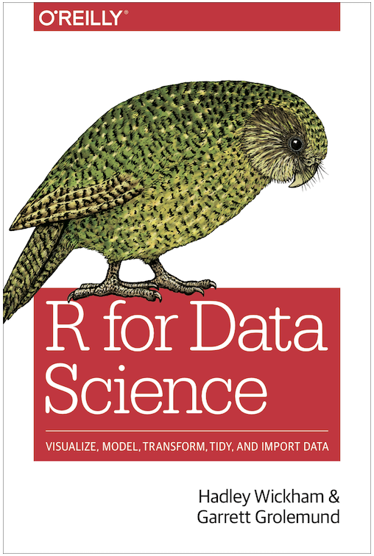

Learning to program
Many suggested readings will include chapters from the ‘R for Data Science’ book.
(https://r4ds.hadley.nz/ )
For text mining, the book ‘Text Mining with R’ is also a reference.
(https://www.tidytextmining.com )
They are both available online for free.
Notes:
There are lots of resources on the internet, forums, such as stackoverflow, Rblogs etc. Don’t hesitate to google if you have a problem.

Slide 37
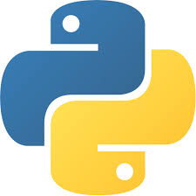


Learning to program
The other main language for data science is ‘Python’.
Python is a language used by engineers, computer scientists.
It is more likely that that the latest machine learning algorithms are first available on python.
Both R & Python have their strength for data science (see this blog) .
If you ever wanted to start using python and still working with R, you can use reticulate.
(David originally learned Python and as part of preparation for this module re-wrote(transpiled) all the materials in Python)
Notes:
There are transferable skills. When you understand how to work with one language you can easily learn how to use another one if necessary. The data pipeline, the programming logic and an planning pipeline of your project is very similar.

Slide 38
Exercises will be in Google colab
It’s no longer 2007 - a lot of computing is done in the cloud especially with data science
Cheaper
Faster
Easier to collaborate
So this year we will be accepting that reality and doing the exercises in the cloud
RStudio cloud is painfully slow (trust me - I did this last year)
The notebook concept is much more appropriate for this module
Colab allows us to choose to work with either R or Python just by changing the runtime (or even by putting the other inside a ‘wrapper’)
Totally free but there are premium options that you won’t need for this module.
But I know that internet is not ubiquitous (at least not yet). So everything is also being made available as a git that you can clone to your own devices.

Slide 39
Why is it important?

Slide 40
Why learning data science?
Science and Innovation policy is evidence based
🡪 Example from Rebecca Endean,
Strategy Director of UK Research and Innovation
Presenting at the ResearchFish conference 2018.
(https://5ba0c32f-08ac-4ea4-84b2-3adc5e339103.filesusr.com/ugd/fc7e18_f53daa3096ed4822a6df0783bfbbfa51.pdf)

Slide 41
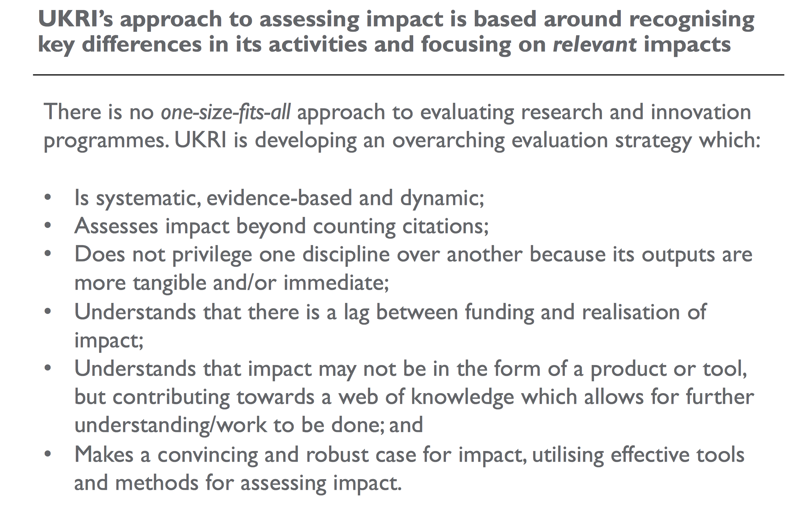
Why learning data science?
Rebecca Endean, UKRI, 2018

Slide 42
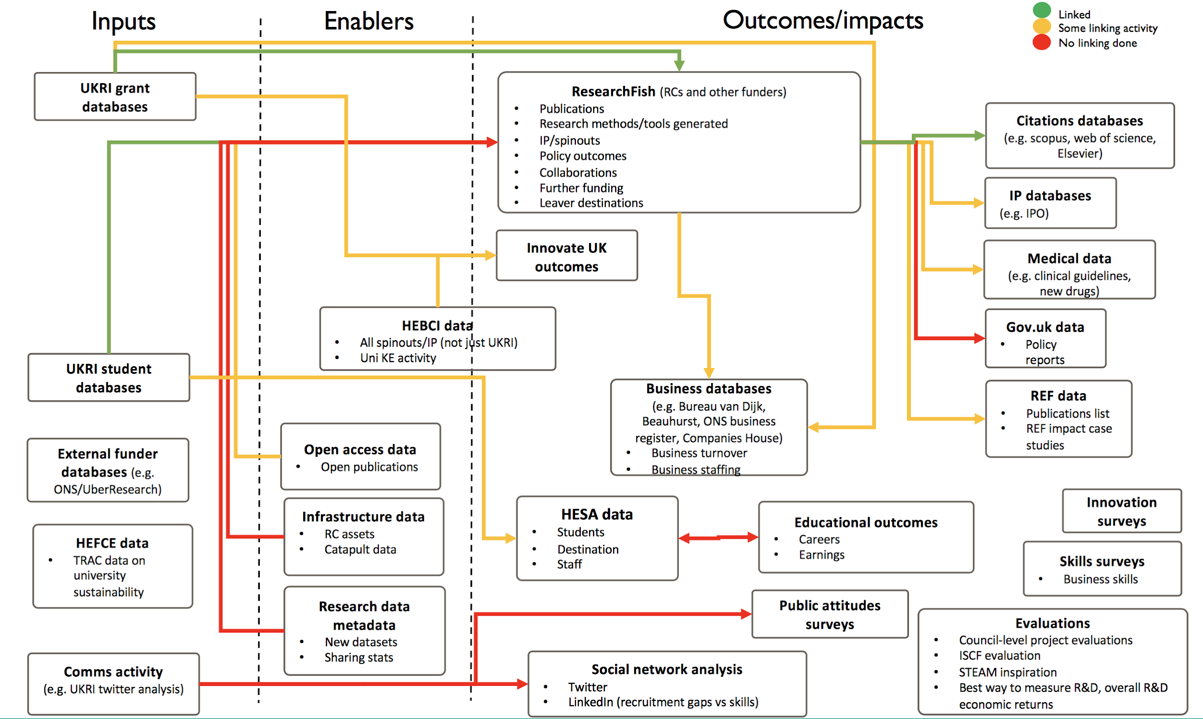
Why learning data science?
UKRI
From data
To measuring impacts
Rebecca Endean, UKRI, 2018

Slide 43
Assessments

Slide 44
Assessments
Learning outcome | Assessment mode
Identify data sources to address research questions and the main ethical concerns associated with data usage | REP
Identify the most appropriate approaches to read, process and transform data | REP, GPN
Describe and apply major text-mining techniques to generate intelligence for decision making | GPN
Employ data analysis techniques to produce effective visualisations | REP, GPN

Slide 45
Assessments
Coursework, (GPN):
Group presentation (30% of the final mark)
A small text mining project.
Timeline:
Week 1-3: creation of groups (3 students)
Week 3-10: project development (including supervision)
Week 11: project submission
Week 11: group presentation
Submit your presentation on Canvas by Week 11.

Slide 46
Assessments
Assessment (REP):
Report – 3000 words (70% of the final mark)
The report will need to examine a topic or a phenomenon related to Science & Technology Policy using the analytical and visualisation techniques introduced in the module
The analysis should rely on a working script in R to be included as part of the report.
The report should draw on the content of other modules that you have attended to produce a critical interpretation of the results of your analysis.
Further details will communicated.

Slide 47
Let’s play!

Slide 48
Overview of RStudio/VScode

Slide 49
Mini Objectives
Guided tour of RStudio
Basic operations in R
Through 4 small exercises:
Do simple computations in R
Use variables in cumulative steps
Glimpse a dataset
Work with R packages (to use specific functions developed by others)
To do the exercises, download the R sheet on canvas.

Slide 50
Rstudio
We are going to work with the RStudio environment.
Use either your own copy of Rstudio (see canvas for installation guide)
Or go to the Sussex server (on campus only):
http://rstudio.uscs.susx.ac.uk/

Slide 51
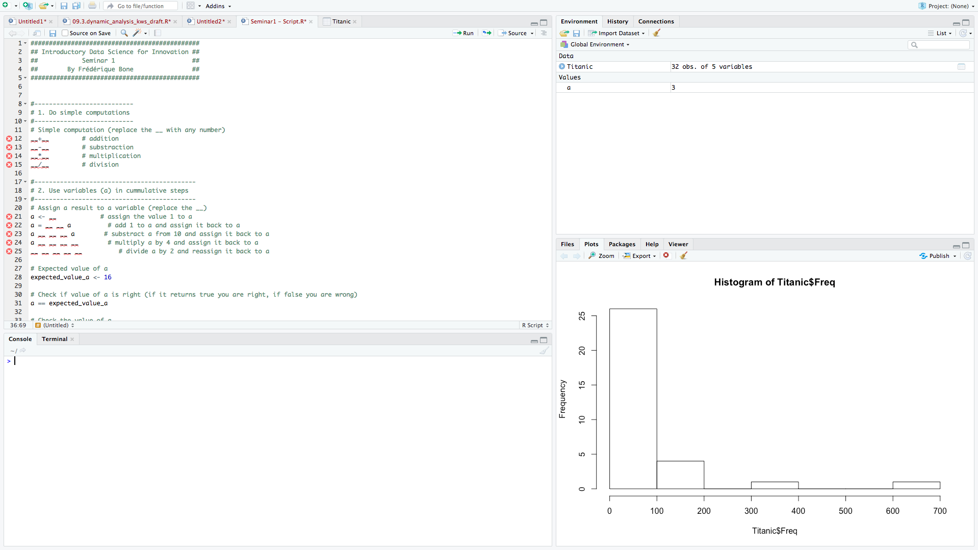
Generic view of RStudio

Slide 52
Generic view of RStudio

Slide 53
Generic view of RStudio
3
2
4 Main tabs
4
1

Slide 54
Generic view of RStudio
3
2
The console
4
1
Notes:
This is where you give a command to the computer
Here the console will translate to the computer what you have said assuming you talk in the language R
The computer will do what you asked it to do
Unless it does not understand what your saying or how to do what you are saying -> ERROR

Slide 55
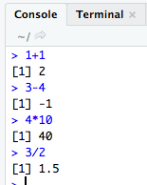
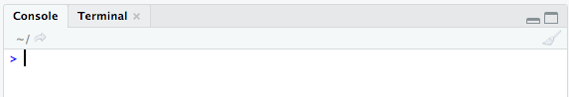
The console
The console :
where you give your instructions for some action to be done.
Try typing some basic operations, and press enter

Slide 56
Generic view of RStudio
3
2
Using scripts
4
1

Slide 57
Using scripts
Scripts:
When you want to write something beyond one operation, it may be useful to create a script.
A script enables you to write all your code in a single document.
Better organisation
Run the same code at a later stage
Let’s upload the exercise script and start exercise 1
Replace _ _ by the correct value

Slide 58
Using scripts
Move to exercise 2.
Using the same operators than in exercise 1 use different steps to change the value of a

Slide 59
Using scripts
Now change the first value of a
Rerun that part of the code.

Slide 60
Generic view of RStudio
3
2
Looking at variables in the environment
4
1

Slide 61
Exploring datasets
Move to exercise 3.
We are going to explore a dataset.

Slide 62
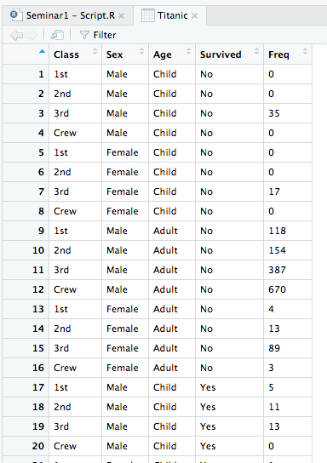
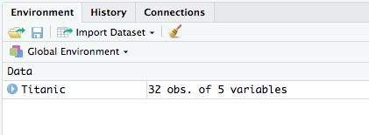
Using scripts
What is the size of the dataset?
What are the main variables of the dataset?

Slide 63
View of RStudio
3
2
Files, Plots, Packages and Help.
4
1

Slide 64
Installing packages
Move to exercise 4 to install packages.

Slide 65
Today’s Agenda and LOs
Who are you?
What are we doing?
How are we going to do this?
What’s going to be on the test?
Playtime!
Know who your module teachers
Understand the module scope
Have a basic understanding of R, Python, and RStudio/VScode
Have a basic insight of the assessment instruments for this module
Understand the very basic functions in R/Python

Slide 66
Thank you. Contact:
David Eggleton
(d.eggleton@sussex.ac.uk)

